Slide 1
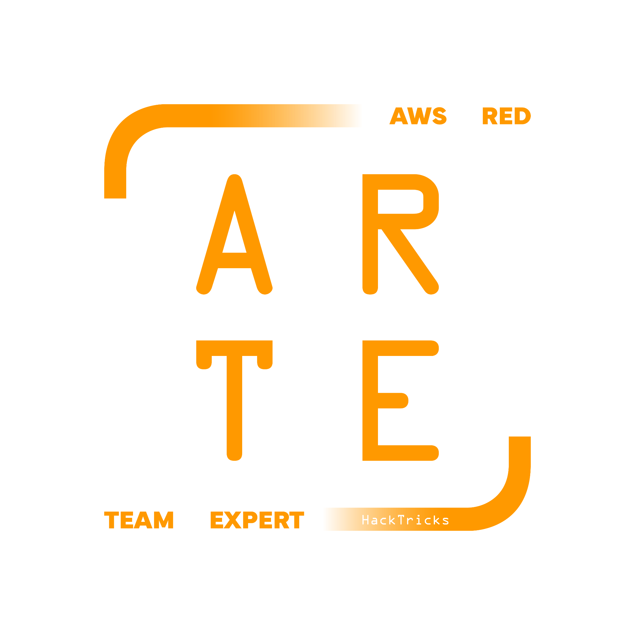
CodeBuild
HackTricks Training
https://t.me/CyberFreeCourses

Slide 2
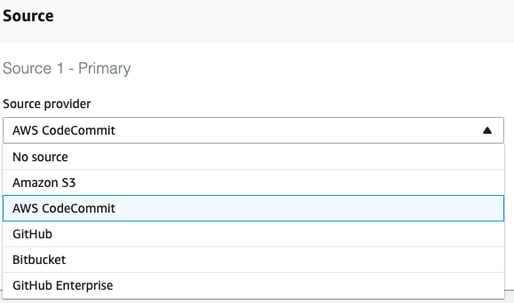
Basic Information
AWS CodeBuild is a fully managed continuous integration service that compiles source code, runs tests, and produces software packages that are ready to deploy. With CodeBuild, you don’t need to provision, manage, and scale your own build servers.
https://t.me/CyberFreeCourses
https://cloud.hacktricks.xyz/pentesting-cloud/aws-security/aws-services/aws-codebuild-enum

Slide 3
Manual Enumeration
# List external repo creds (such as github tokens)
## It doesn't return the token but just the ARN where it's located
aws codebuild list-source-credentials
# Projects
aws codebuild list-shared-projects
aws codebuild list-projects
aws codebuild batch-get-projects --names <project_name> # Check for creds in env vars
# Builds
aws codebuild list-builds
aws codebuild list-builds-for-project --project-name <p_name>
aws codebuild list-build-batches
aws codebuild list-build-batches-for-project --project-name <p_name>
# Reports
aws codebuild list-reports
aws codebuild describe-test-cases --report-arn <ARN>
https://t.me/CyberFreeCourses
https://cloud.hacktricks.xyz/pentesting-cloud/aws-security/aws-services/aws-codebuild-enum

Slide 4
Privilege Escalation
iam:PassRole, codebuild:CreateProject, (codebuild:StartBuild | codebuild:StartBuildBatch)
Compromise any codebuild IAM role.
iam:PassRole, codebuild:UpdateProject, (codebuild:StartBuild | codebuild:StartBuildBatch)
Compromise any codebuild IAM role.
https://t.me/CyberFreeCourses
https://cloud.hacktricks.xyz/pentesting-cloud/aws-security/aws-privilege-escalation/aws-codebuild-privesc

Slide 5
Post Exploitation
DEMO
Abuse CodeBuild Repo Access
Dump all the code of the accessible private repos
Leaking Access Tokens from AWS CodeBuild (fixed, but… new method!)
https://cloud.hacktricks.xyz/pentesting-cloud/aws-security/aws-post-exploitation/aws-codebuild-post-exploitation/aws-codebuild-token-leakage
codebuild:DeleteProject
Delete the project
codebuild:TagResource , codebuild:UntagResource
Affect the tags of the resources
codebuild:DeleteSourceCredentials
Deleted configured credentials
https://t.me/CyberFreeCourses
https://cloud.hacktricks.xyz/pentesting-cloud/aws-security/aws-post-exploitation/aws-codebuild-post-exploitation
Notes:
https://www.loom.com/share/a5459e36919d4808bbfd97b444bd2a83

Slide 6
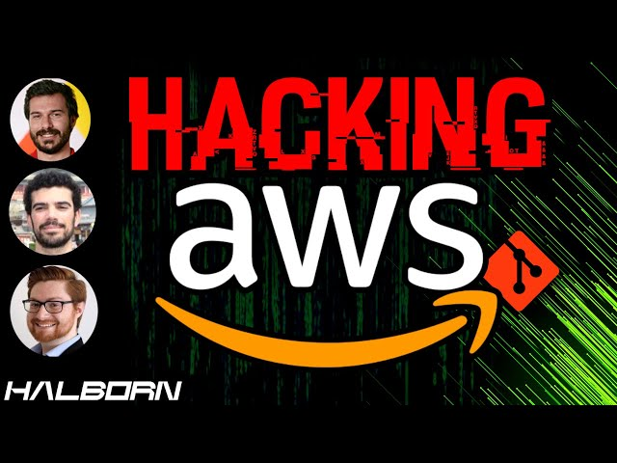
Post Exploitation
DEMO
https://www.youtube.com/watch?v=saVx9rShKvA
https://t.me/CyberFreeCourses
https://cloud.hacktricks.xyz/pentesting-cloud/aws-security/aws-post-exploitation/aws-codebuild-post-exploitation
Notes:
https://www.loom.com/share/a5459e36919d4808bbfd97b444bd2a83

Slide 7
Extra Resources
https://www.youtube.com/watch?v=IzdWk6nA_Ho
https://www.youtube.com/watch?v=UbfhVXJn6fk
https://www.youtube.com/watch?v=saVx9rShKvA
https://www.youtube.com/watch?v=FBWpX8icMMo
https://www.youtube.com/watch?v=S1-vGf_ao1s
https://www.youtube.com/watch?v=IyLWAZlzPNM
https://www.youtube.com/watch?v=lTVY01pbMvM
https://t.me/CyberFreeCourses

